Slide 1
Portfolio Website Design
Muhamad Hafizuddin Ali

Slide 2
Project Objective
Requirement for Adnexio Edu Software Engineering Conversion Bootcamp #7
Introduce the personnel to the potential employers or customers through the ‘About Me’ section.
Demonstrating skills and expertise by listing down skills and projects to potential employers or customers through the ‘Skills’ and ‘Projects’ sections.
Build credibility and trust through the websites.
As a platform to connect with interested employers and customers.

Slide 3
Target Audience

Slide 4
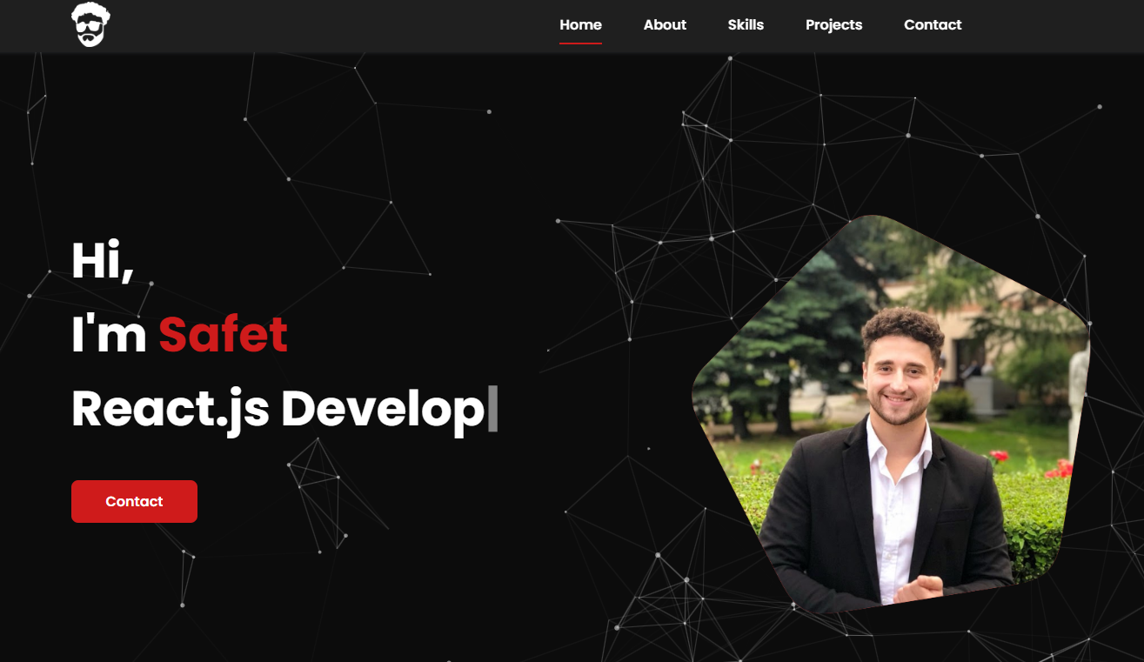

Inspirations
neat design
~black/dark b/ground
welcome message
~white/red combination
~photo in polygon
student photo

Slide 5
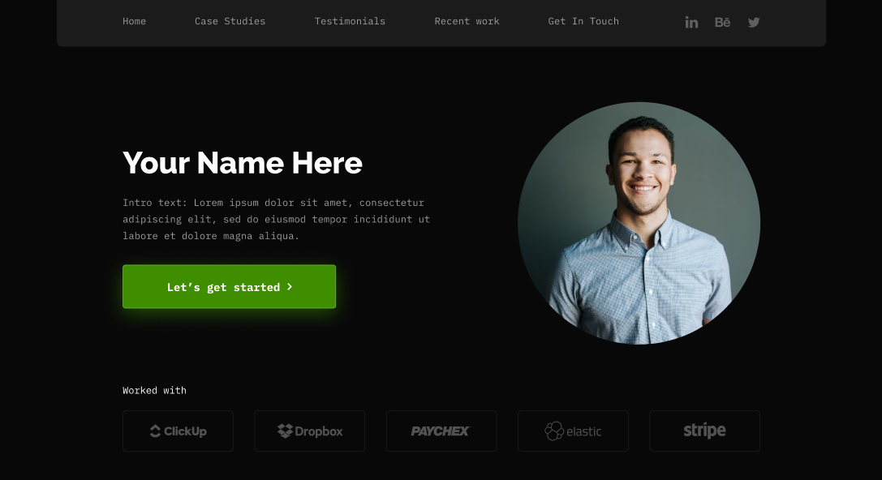
Inspirations

Slide 6
Design Decision
Dark background – prefer dark blue
White and a little bit of red color for text
Red button

Slide 7
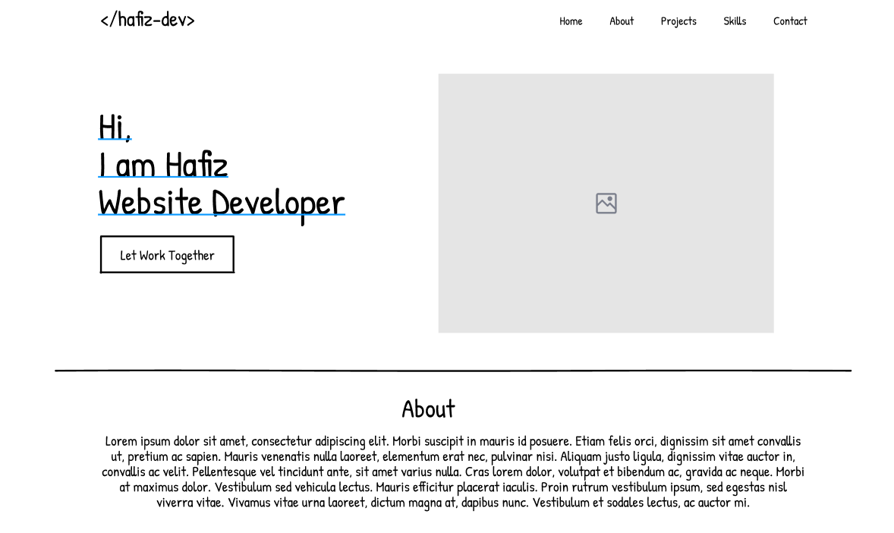
Wireframes

